Slide 1
UPSET and ANGRI: Breaking High Performance Image Classifiers (Upset & Angri)
Sayantan Sarkar University of Maryland
2017 未发表

Slide 2
Outline
Scenario
Observe Imagine
Problem
Multiple Angles
Solution
Theory Tool
Performance
Effectiveness Cost

Slide 3
1
Scenario & Problem
Scenario:
Two black attack methods
UPSET（Universal Perturbations for Steering to Exact Targets）
ANGRI（Antagonistic Network for Generating Rogue Images）
Reference: UPSET and ANGRI : Breaking High Performance Image Classifiers

Slide 4
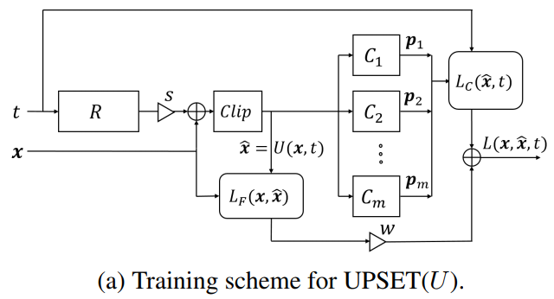
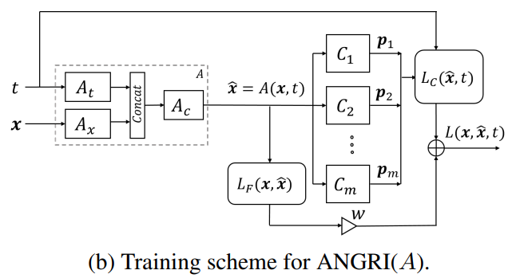
3
Solution

Slide 5
4
Performance
Evaluation：
Targeted fooling rate (TFR)
Misclassification rate (MR)
Fidelity score (FS)
Confidence (C)

Slide 6
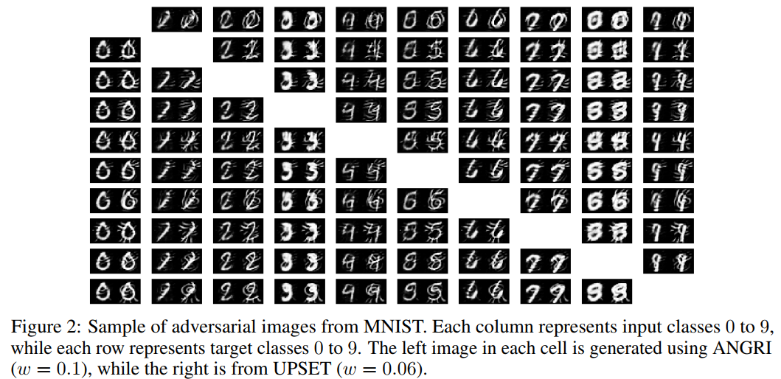
4
Performance

Slide 7
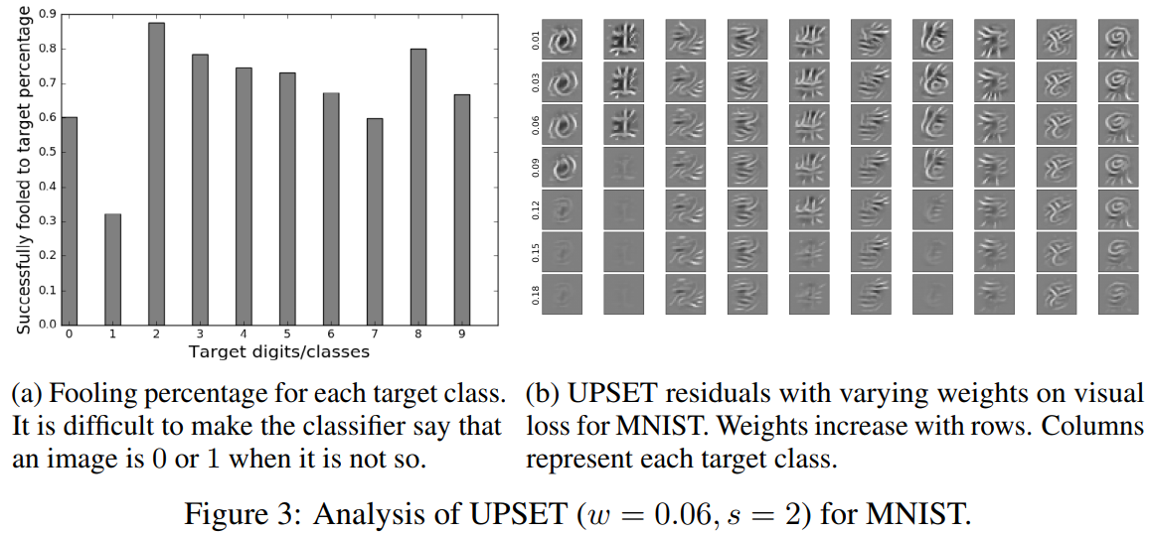
4
Performance

Slide 8
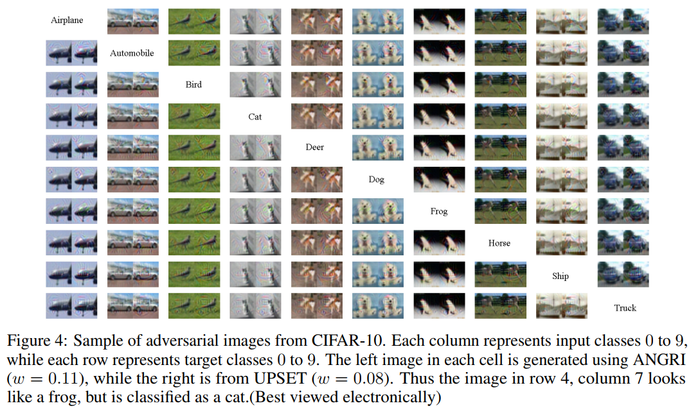
4
Performance

Slide 9
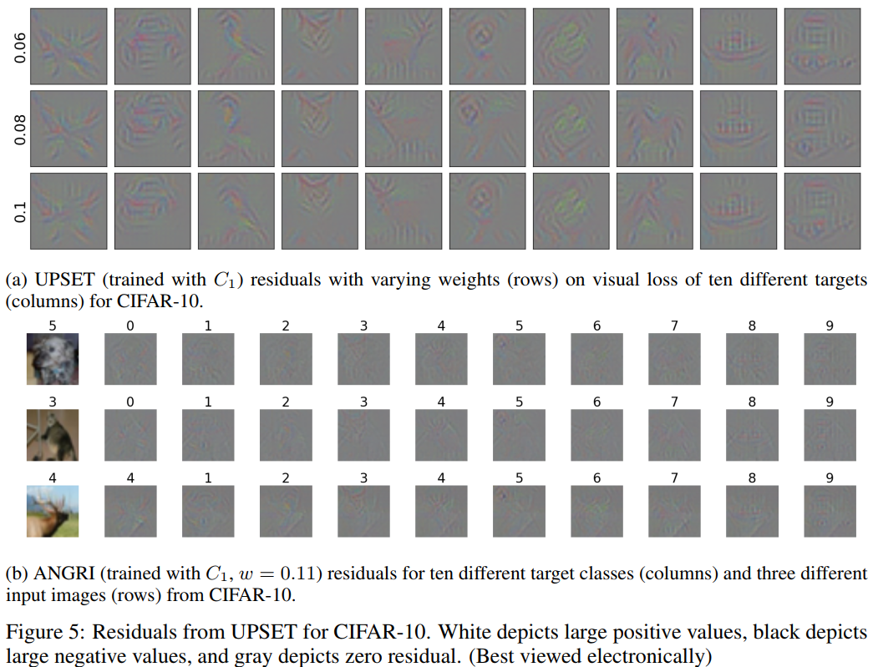
4
Performance

Slide 10
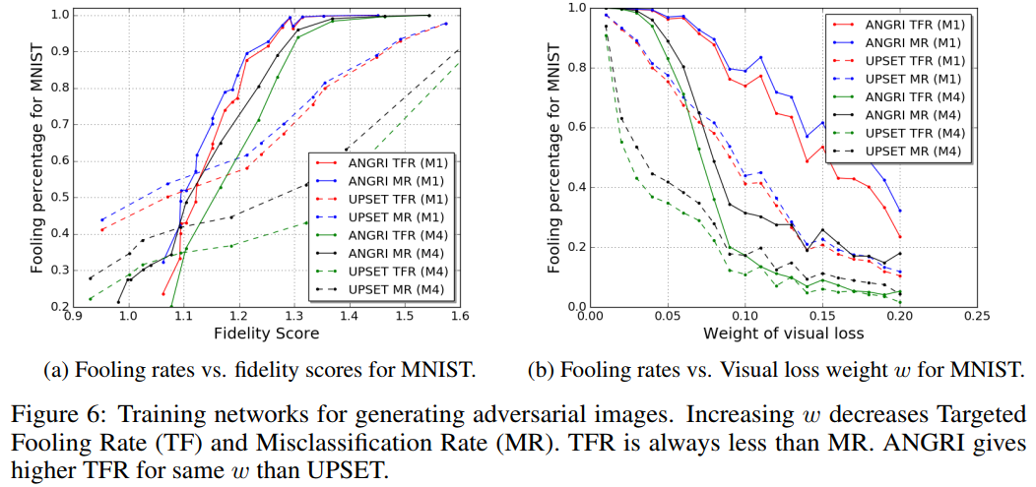
4
Performance

Slide 11
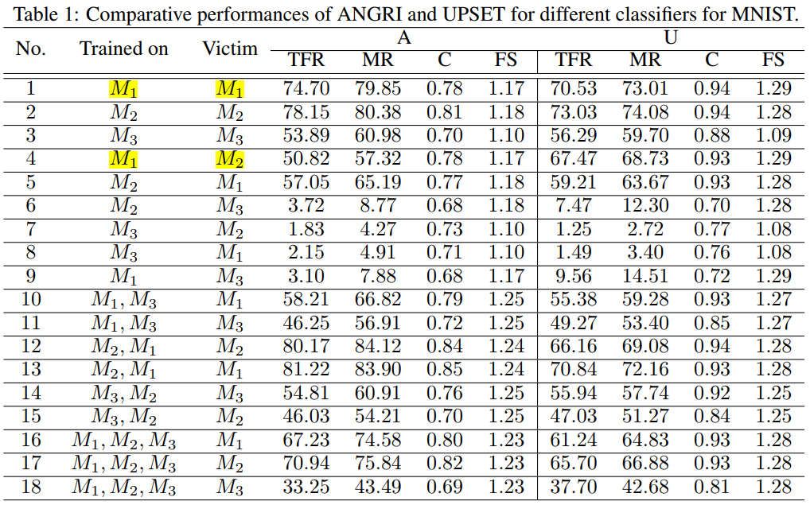
4
Performance

Slide 12
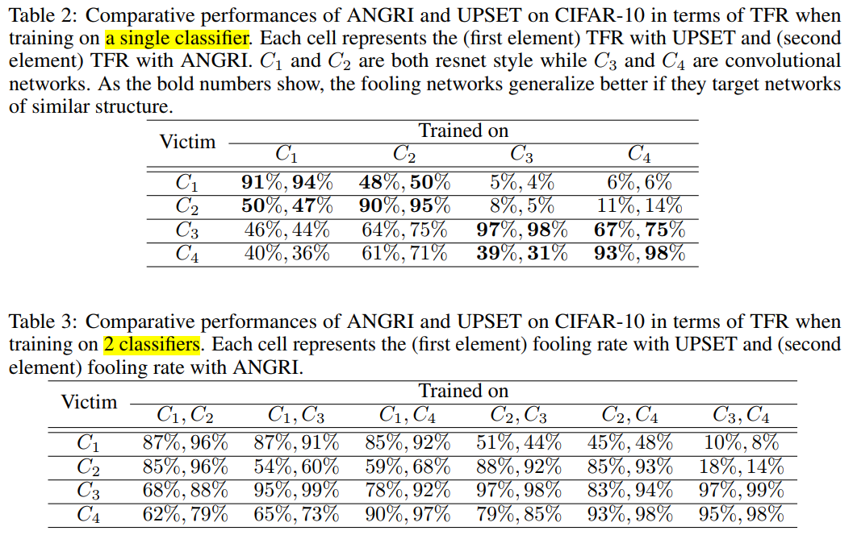
4
Performance

Slide 13
4
Conclusion
UPSET：用R网络生成对抗扰动
ANGRI：用A网络生成对抗样本
本文问题：术语使用不规范，例如residual原来只残差网络，这里指perturbation
R和A的损失函数梯度更新过程没解释，不知道是如何得到最优对抗扰动或对抗样本的。

